Slide 1

Jigsaw Comments Classification
Dave Wei

Slide 2
Thinking Progress
1
2
3
4
5
Look into Data
Why this is important
Solve it
Evaluation
Improvement

Slide 3
A Glimpse into Our Data
Training data
 | id | comment_txt | toxic | severe_toxic | obscene | threat | insult | identity_hate
0 | 22256635 | Nonsense? kiss off, geek. what I said is true... | 1 | 0 | 0 | 0 | 0 | 0
1 | 27450690 | "\n\n Please do not vandalize pages, as you did ... | 0 | 0 | 0 | 0 | 0 | 0
Toxic: “Nonsense? kiss off, geek. what I said is true. I'll have your account terminated.”
Clean: “Please do not vandalize pages, as you did with this edit to W. S. Merwin. If you continue to do so, you will be blocked from editing.”

Slide 4

A Glimpse into Our Data
Testing data
 | id | comment_txt
226993 | 999966872214 | *{Persondata
226994 | 999968525410 | '' — is wishing you a [WIKI_LINK: Mary Poppin...
226995 | 999980053494 | ==Fair use rationale for [WIKI_LINK: Image:D.R...
226996 | 999980680364 | == Employment Practices at Majestic ==
226997 | 999997819802 | Welcome to Wikipedia. Although everyone is wel...
Sequence Classification Problem

Slide 5


Why Should We Do This?
Help Online Discussion Become More Productive and Respectful
Improve Customer Stickiness
Reduce the Need for Human Labor
Reddit
Dota2

Slide 6
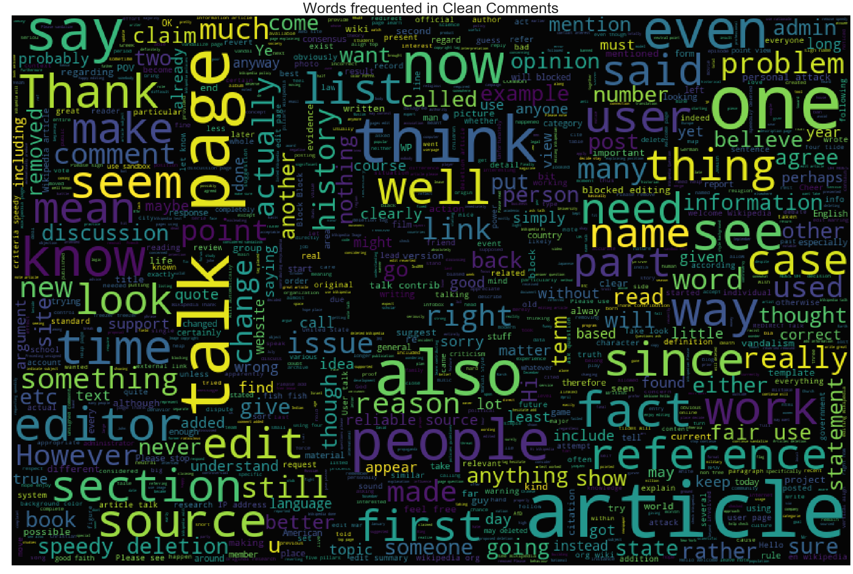
Word Cloud
Clean comments

Slide 7

Clean comments

Slide 8
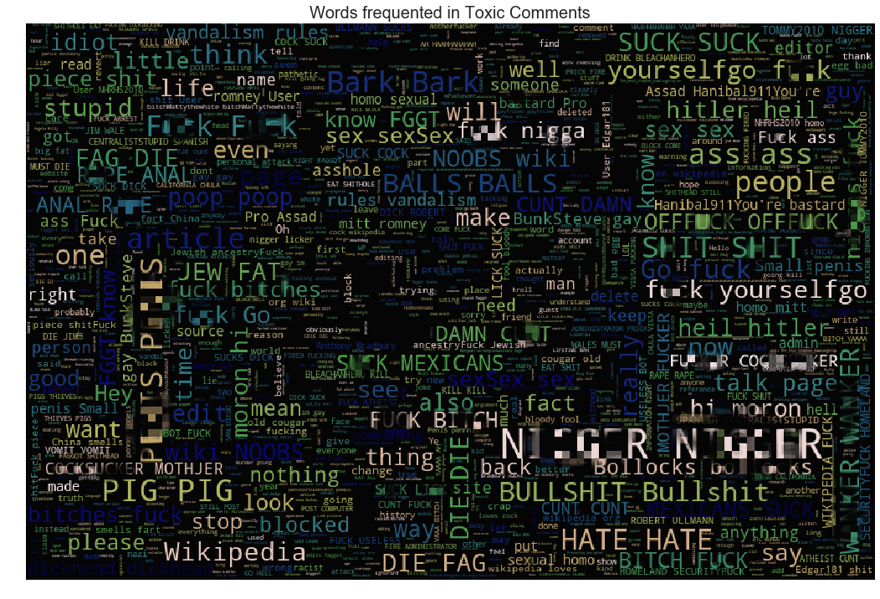
Word Cloud
Toxic comments

Slide 9
Statistics
Data Split
Number of training data : 95851
Number of testing data : 226998
Training data : testing data = 3 : 7
Missing Value
Only found one in testing dataset

Slide 10
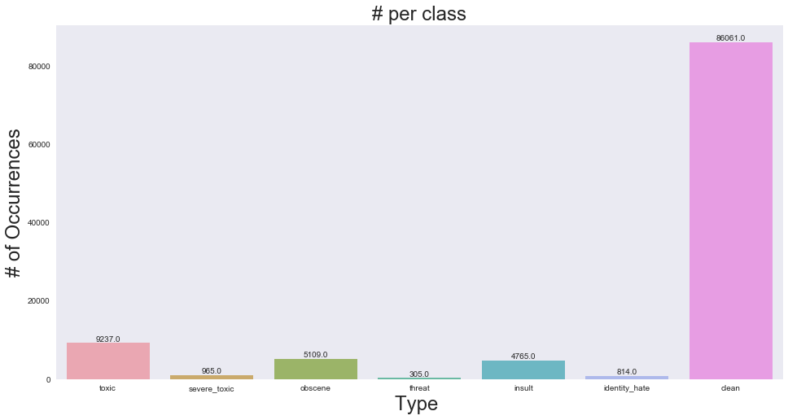
Statistics
Class Imbalance
Total: 95851
Clean: 86061
Type: 21195

Slide 11
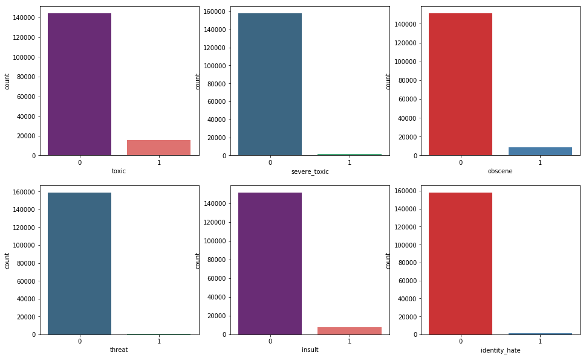
Statistics
Class Imbalance

Slide 12
Classification
TF-IDF + Logistic Regression
Toxic ROC AUC: 98.48% Severe_toxic ROC AUC: 99.22% Obscene ROC AUC: 99.36% Threat ROC AUC: 99.45% Insult ROC AUC: 98.80% Identity_hate ROC AUC: 98.98%

Slide 13
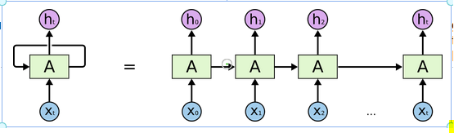
Classification
Recurrent Neural Network

Slide 14
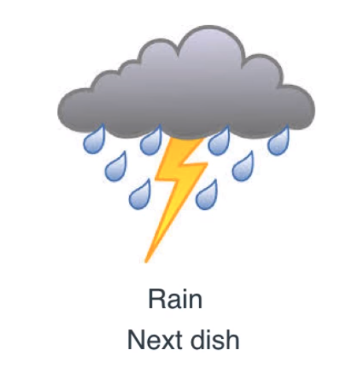
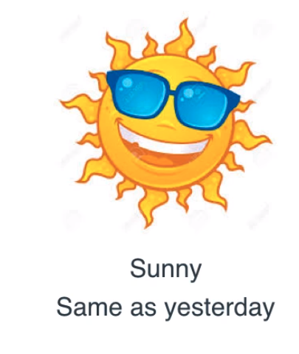

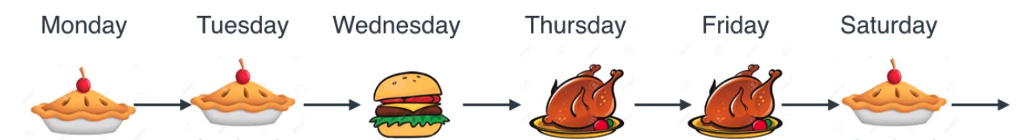


Classification
Example: Cooking Schedule
Original Schedule
Weather info

Slide 15
Classification
Sequence Learning Problems
Vanilla RNN: I live in Brazil, I speak ______
LSTM: I live in Brazil, I like playing football with my friends and going to the school, I speak ______
Bidirectional LSTM: I live in Brazil, I like playing _______ with my friends and my favorite player is Ronaldo, I speak portuguese

Slide 16
Classification
LSTM model & Bidirectional LSTM model
Batch size = 32, epochs = 2, max_features = 20000, max length = 100
 | Accuracy | Loss
LSTM | 98.32% | 0.53
Bidirectional LSTM | 98.34% | 0.527

Slide 17
Next Steps
Improve LSTM model
GLoVe, Dropout
Feature engineering
Number/portion of capitals
Try more models and ensemble
SVM, Naive-Bayes

Slide 18
Questions ?

Slide 21
Features
How usually do people express their anger?
Number/portion of capitals - observation was many toxic comments being ALL CAPS
Number of exclamation marks - i observed several toxic comments with multiple exclamation marks
Number of symbols/punctuations - assumtion that words like fck or $# or sh*t mean more symbols in foul language
Number of unique words - observation that angry comments are sometimes repeated many times
Number of (happy) smilies - Angry people wouldn't use happy smilies (Sarcasm?)

